Slide 1
An Introduction to
Reinforcement Learning
By Christopher Torrington

Slide 2
Talk about training dogs

Slide 3
Not doing GPI – doing eval & iteration separately. No Dynamic programming

Slide 4
Markov Decision Process

Slide 5
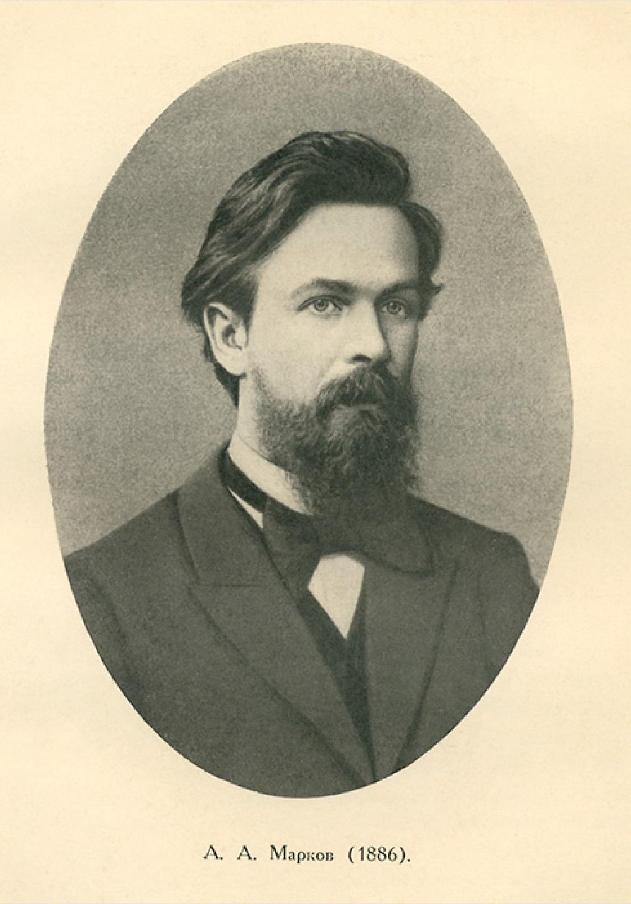
Andrey Markov
Notes:
The name of MDPs comes from the Russian mathematician Andrey Markov as they are an extension of Markov chains.

Slide 6
Main
Space
Reward
+
0.5
Academy Room
1
No reward
0
Outside
- reward

Slide 7
Agent-Environment Interactions
S₀
A₀
R₁
S₁
A₁
R₂
S₂
A₂
R₃
S₃
A₃
R₄
…

